Slide 1
Docker/Kubernetes Demo
Quick overview of Docker/Kubernetes principles and practices
Monica Marshall 9/23/2020
Demo: https://github.com/monicamarshall/MessageBoardApp

Slide 2
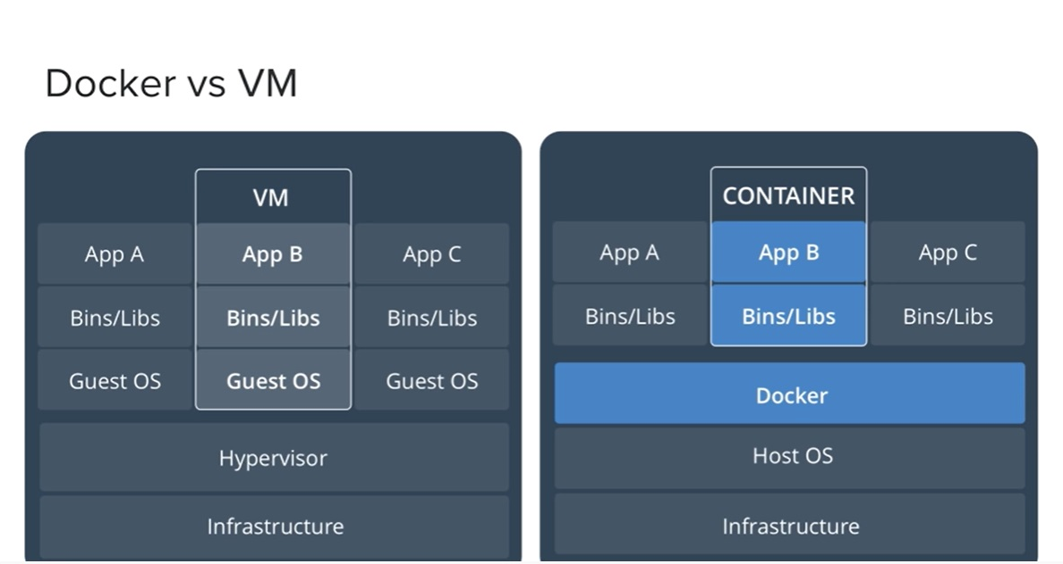
Docker vs VM

Slide 3
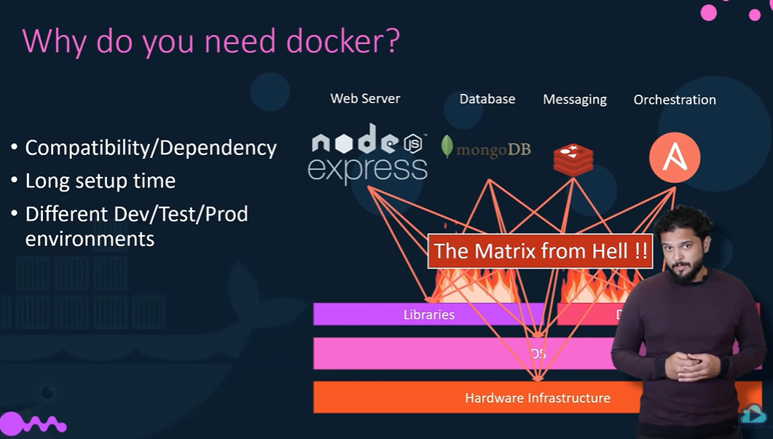
Why Docker? From hell …

Slide 4
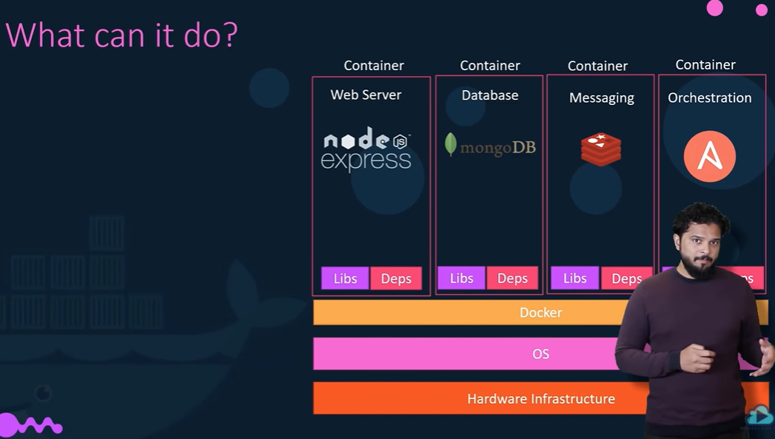
…To Heaven

Slide 5
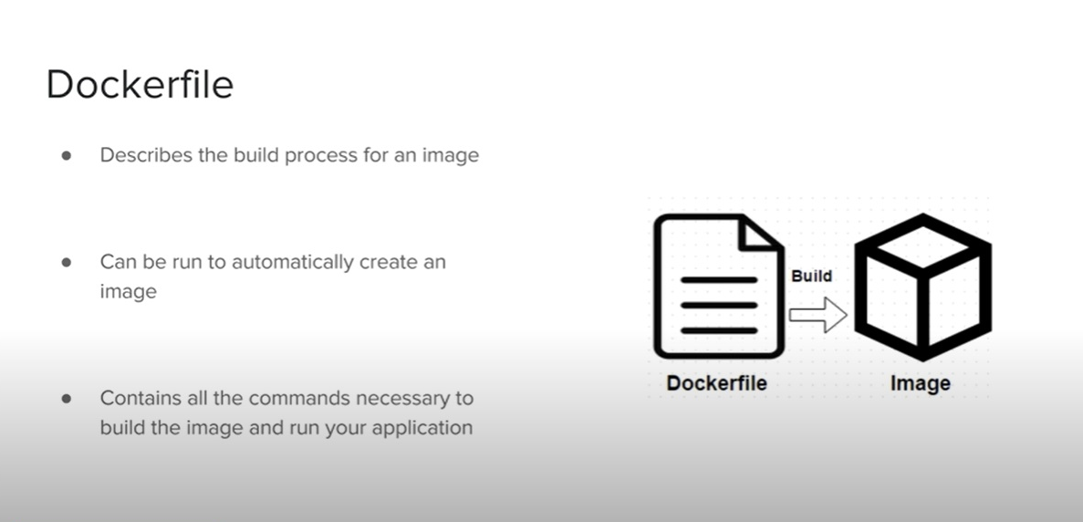
Dockerfile/Docker image

Slide 6
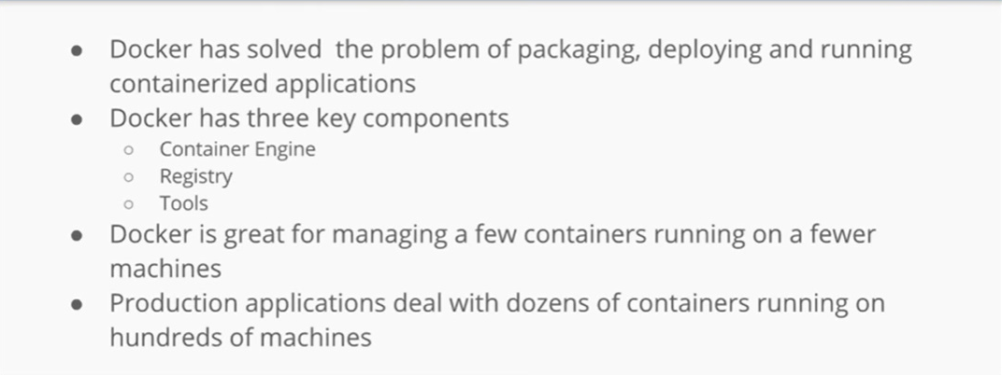
Why Docker?

Slide 7
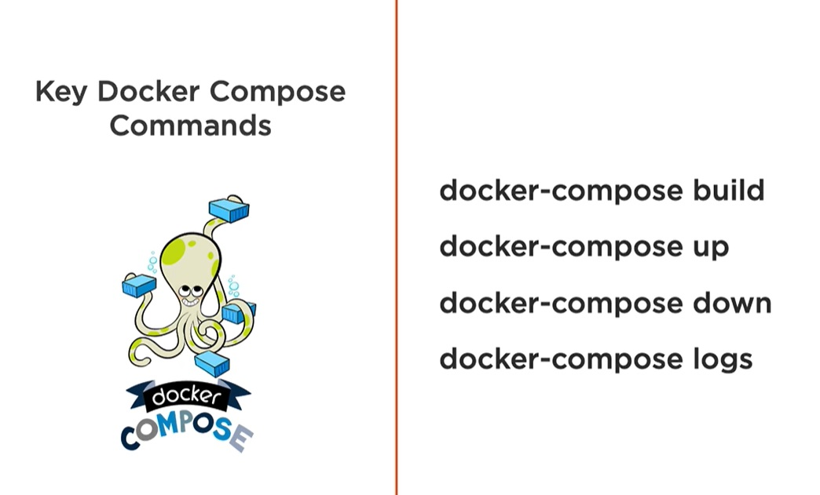
Docker-compose

Slide 8
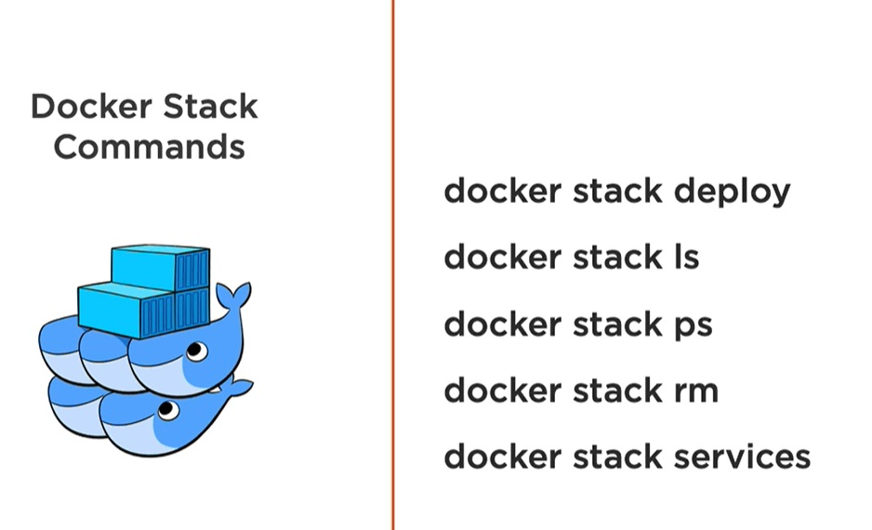
Docker stack

Slide 9
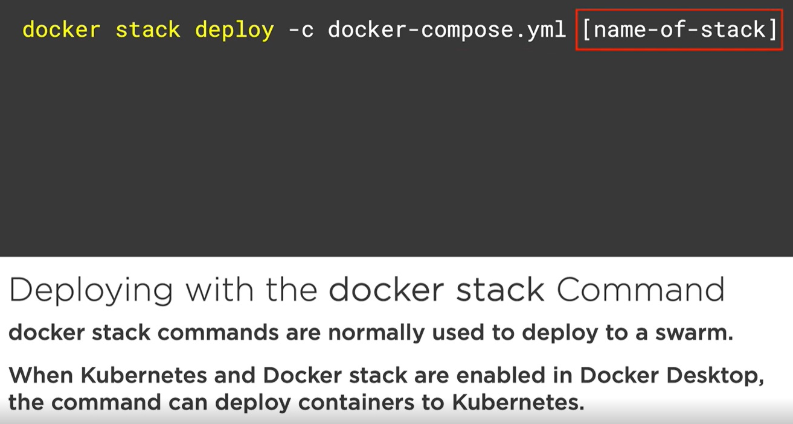
Docker stack command

Slide 10
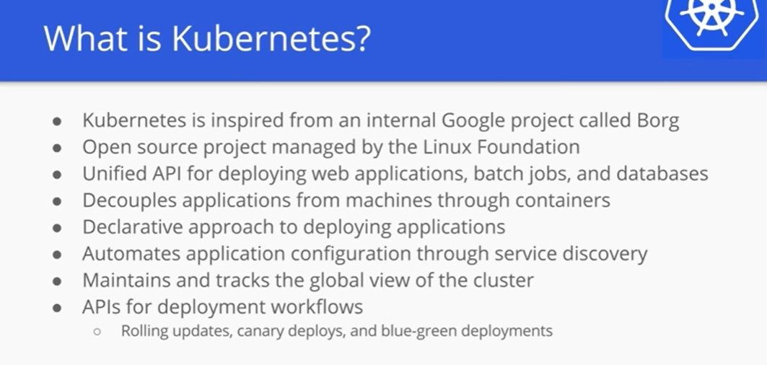
What is Kubernetes?

Slide 11
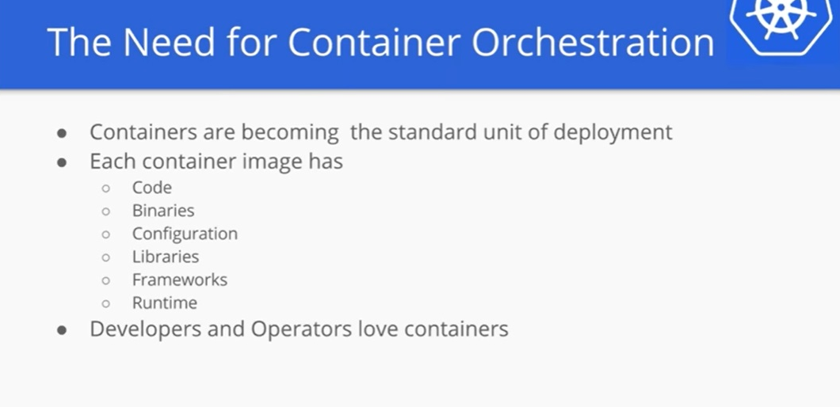
Need for Container Orchestration

Slide 12
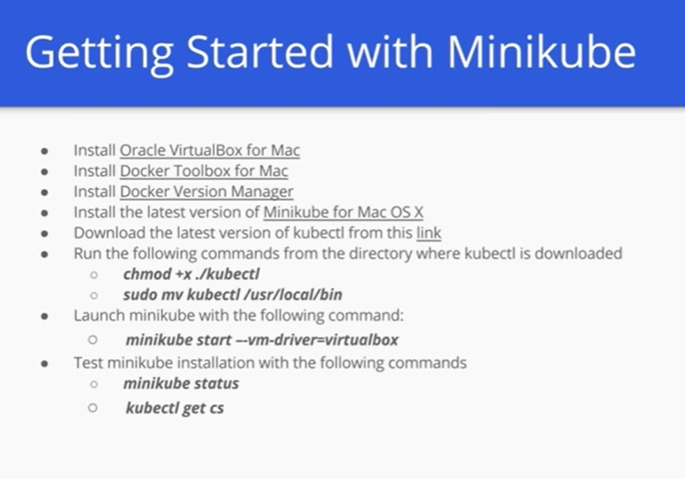
Getting started

Slide 13
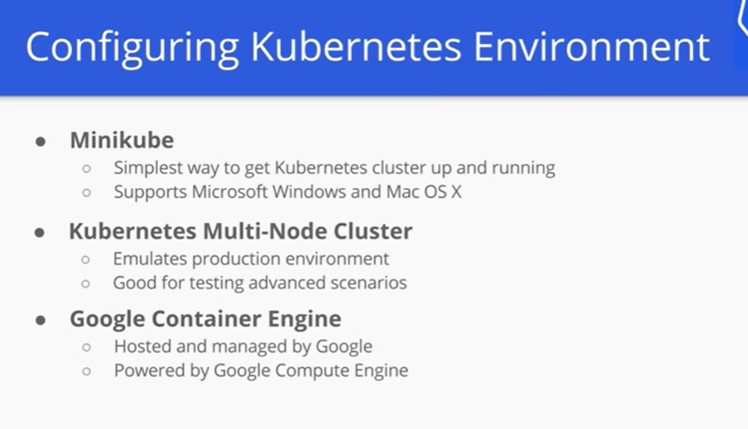
Configure Kubernetes

Slide 14
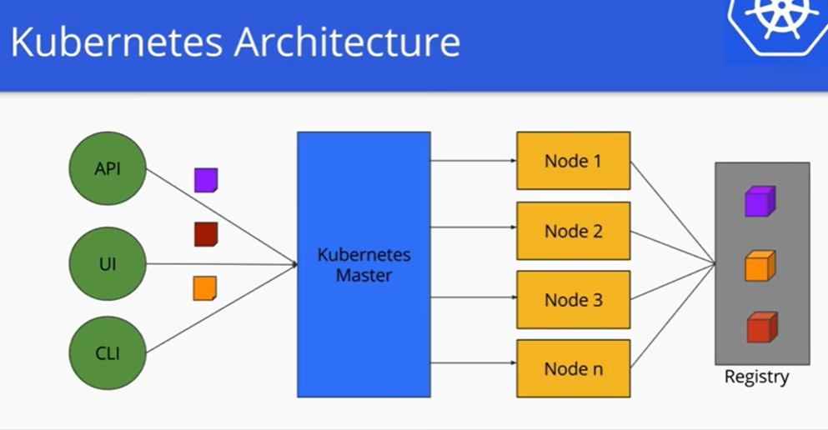
Kubernetes Architecture

Slide 15
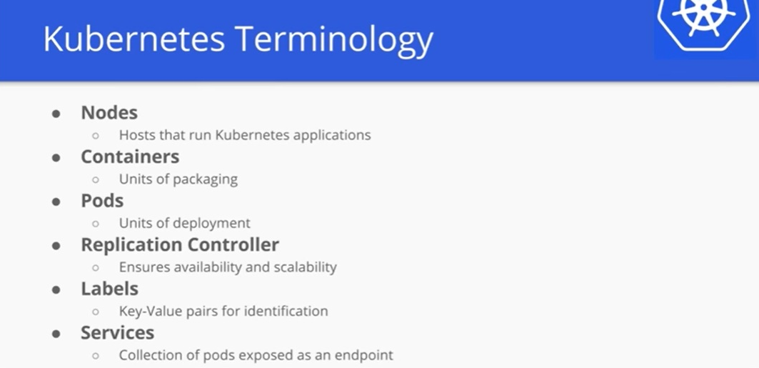
Kubernetes Terminology

Slide 16
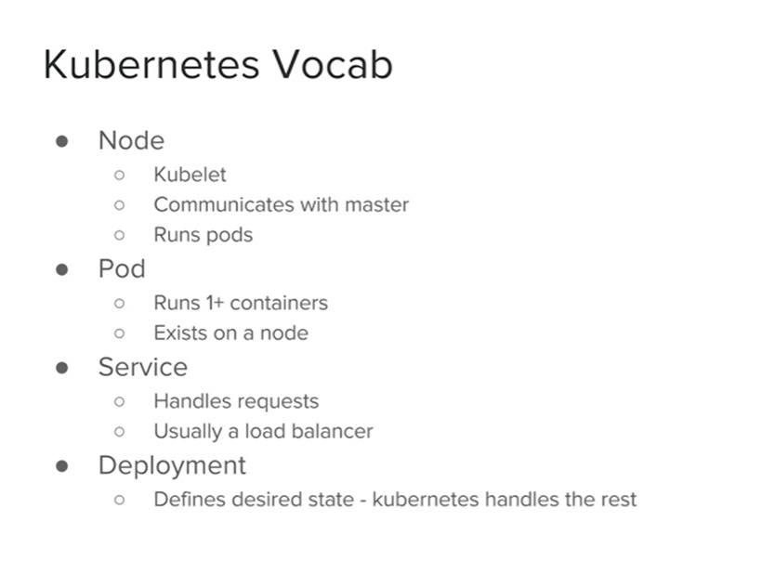
Kubernetes Vocab

Slide 17
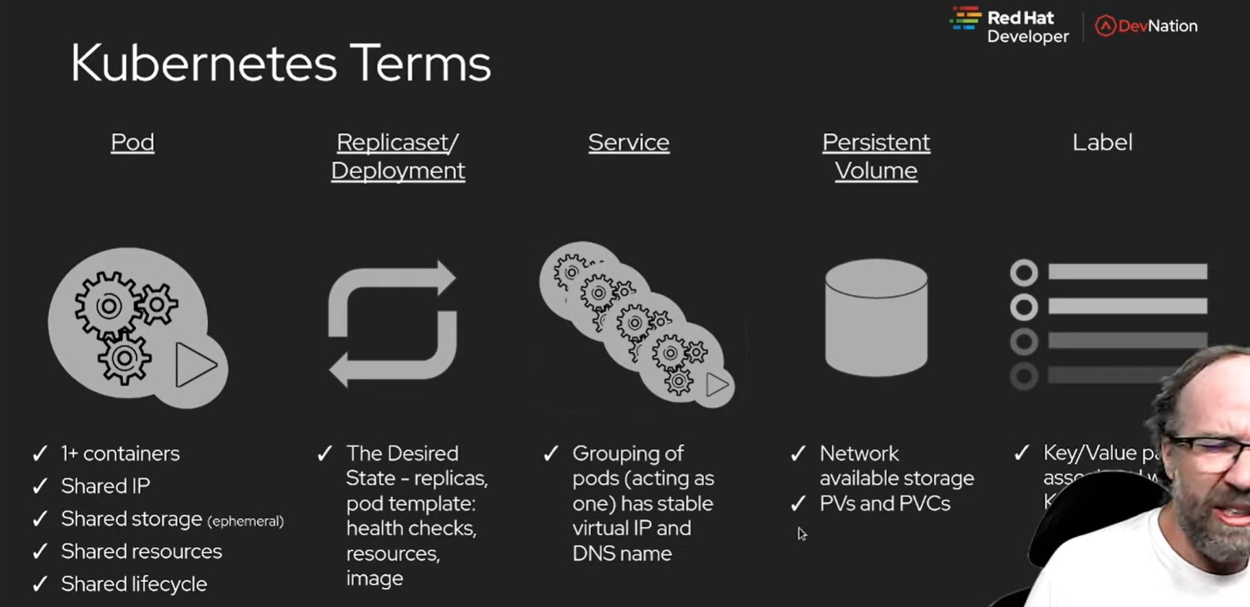
Kubernetes Terms

Slide 18
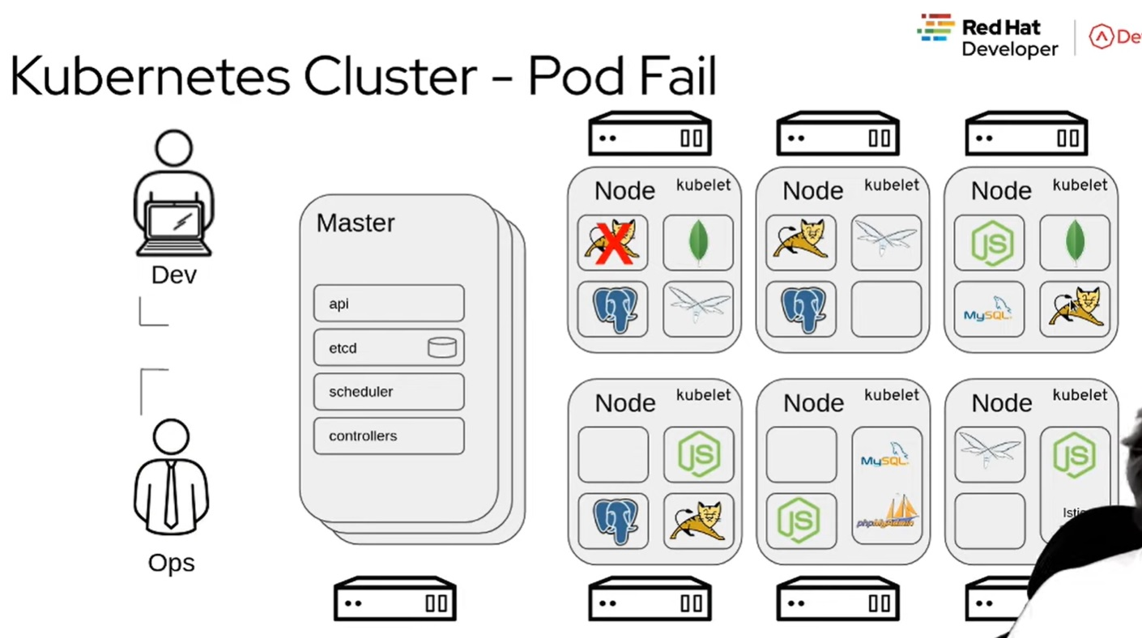
Kubernetes cluster

Slide 19
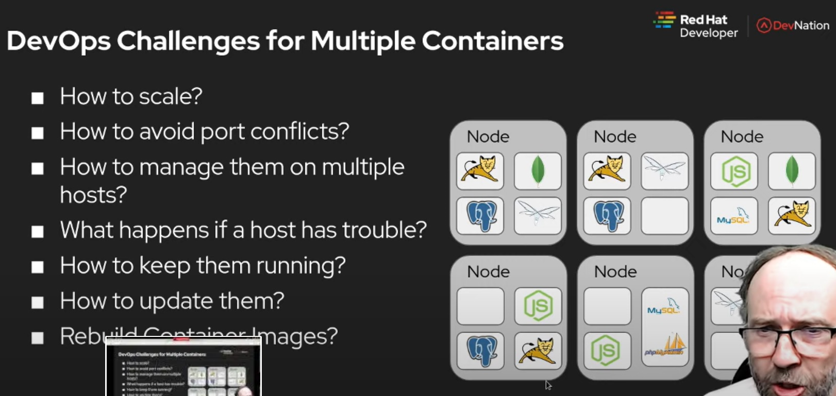
Challenge for multi-container env

Slide 20
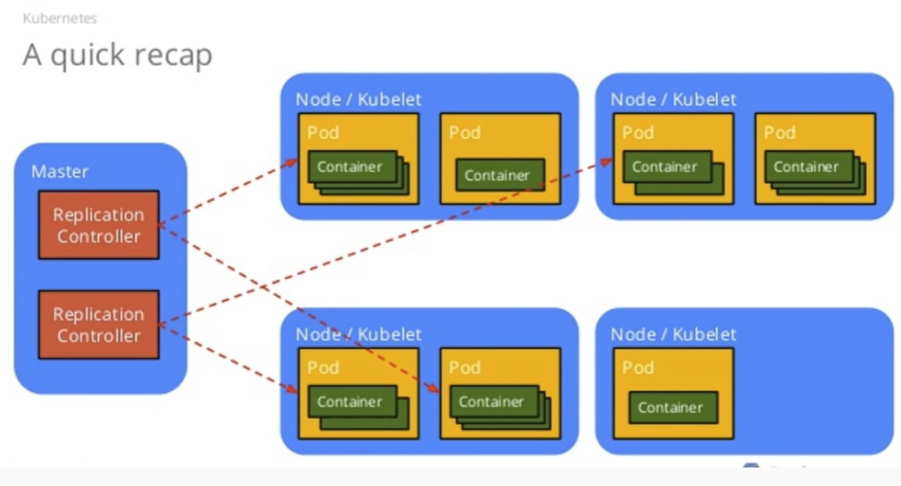
Quick Recap

Slide 21
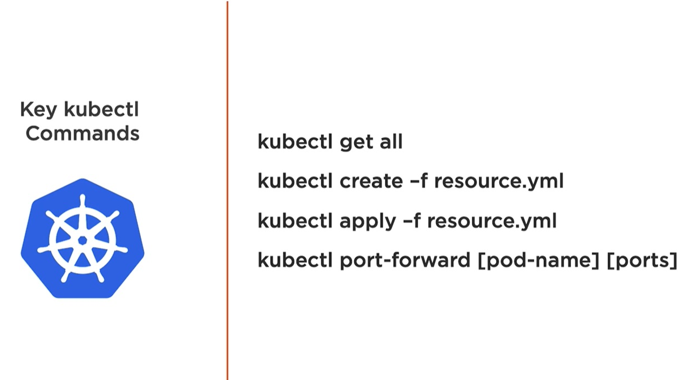
Kubectl commands

